Slide 1
Approximate user’s path

Slide 2
Problems of inferring user’s mobility mode
Records are discrete in time
Inaccurate distance
Lack of ground truth
We can extra these info from the traces:
when did a user switch towers -> infer moving time
From which tower to which tower -> infer moving distance

Slide 3

How to estimate user’s speed
We can extract information of Events A&B from traces.
Then we can use distance of the estimated path (red line) and time interval of event A and event B to calculate the user’s speed during this time
Note that we don’t know the exact place of event A&B, we only know they happened near the boundaries.
Event B
Event A

Slide 4
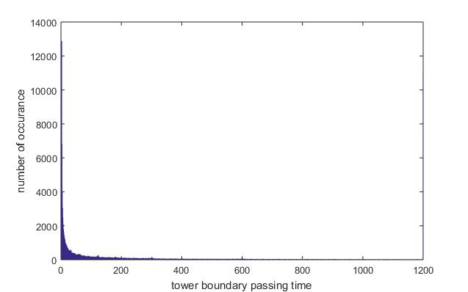
The accuracy of event timestamps
Errors will be introduced when we trying to infer exact boundary passing time.

Slide 5
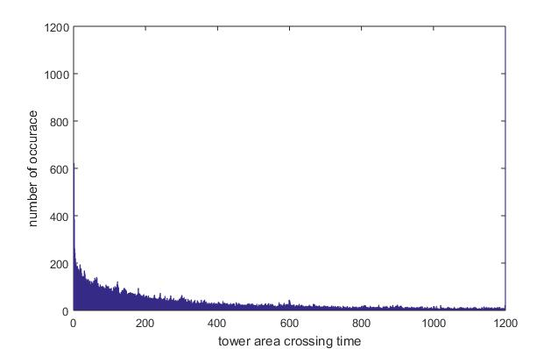
The distribution of user’s moving time
No longer power law
Still have some very short crossing time, means there are a lot of ‘false passing’.
Longer time may be caused by low speed or stay in the area.

Slide 6
How to estimate user’s moving distance
Method 1:
We use the square root of the communication area that Voronoi map suggest to approximate the distance.
Event B
Event A

Slide 7
How to estimate user’s moving distance
Method 2:
We use google’s API to get the distance of tower red to tower green (yellow line) and distance of tower green to tower blue (red line).
Then we add half of both of them to estimate the distance.
Note that the distance of yellow line and red line is estimated by google through real road networks which does not show here. We are not using straight line distance.
Event B
Event A

Slide 8
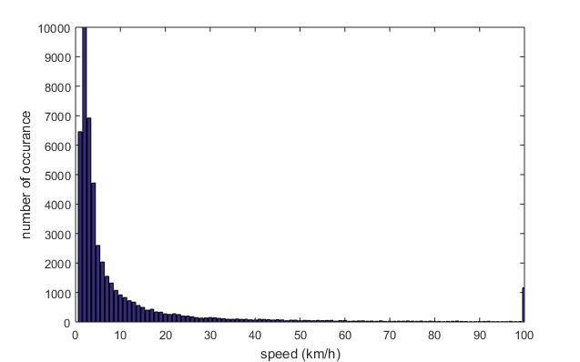
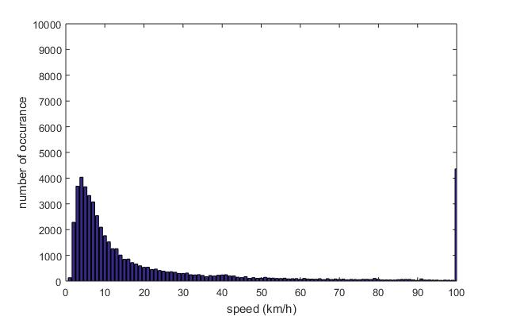
The estimated speed
Method 1
Method 2

Slide 9
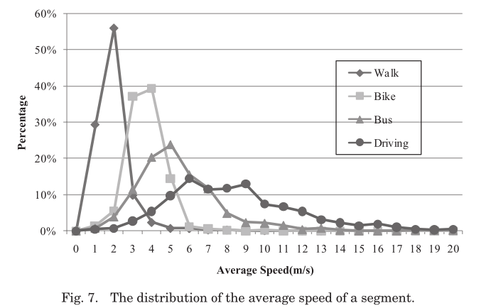
The average speed of different transportation modes
Understanding Transportation Modes Based on GPS Data for Web Applications

